Slide 1
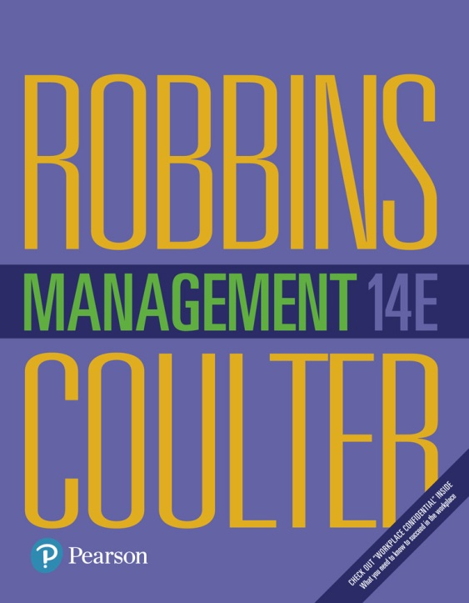
Management
Fourteenth Edition
Chapter 3
Managing the External Environment and the Organization’s Culture
Copyright © 2018, 2016, 2014 Pearson Education, Inc. All Rights Reserved

Slide 2
Learning Objectives
3.1 Contrast the actions of managers according to the omnipotent and symbolic views.
3.2 Describe the constraints and challenges facing managers in today’s external environment.
Develop your skill at scanning the environment so you can anticipate and interpret changes taking place.
3.3 Discuss the characteristics and importance of organizational culture.
Know how to read and assess an organization’s culture.
3.4 Describe current issues in organizational culture.

Slide 3
The Manager: Omnipotent or Symbolic?
Omnipotent view: managers are directly responsible for an organization’s success or failure
Symbolic view: much of an organization’s success or failure is due to external forces outside managers’ control
Notes:
How much difference does a manager make in how an organization performs? The dominant view in management theory and society in general is that managers are directly responsible for an organization’s success or failure. We call this perspective the omnipotent view of management. In contrast, others have argued that much of an organization’s success or failure is due to external forces outside managers’ control. This perspective is called the symbolic view of management.

Slide 4
Managerial Constraints
In reality, managers are neither all-powerful nor helpless. But their decisions and actions are constrained.
External constraints come from the organization’s environment and internal constraints come from the organization’s culture
Notes:
In reality, managers are neither all-powerful nor helpless. But their decisions and actions are constrained. As you can see in Exhibit 3-1, external constraints come from the organization’s environment and internal constraints come from the organization’s culture.

Slide 5
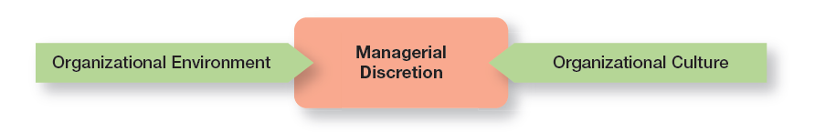
Exhibit 3-1 Constraints on Managerial Discretion
Exhibit 3-1 shows that external constraints come from the organization’s environment and internal constraints come from the organization’s culture.

Slide 6
The External Environment
Those factors and forces outside the organization that affect its performance
Economic
Demographic
Political/Legal
Sociocultural
Technological
Global
Notes:
The economic component encompasses factors such as interest rates, inflation, changes in disposable income, stock market fluctuations, and business cycle stages.
The demographic component is concerned with trends in population characteristics such as age, race, gender, education level, geographic location, income, and family composition.
The political/legal component looks at federal, state, and local laws as well as global laws and laws of other countries. It also includes a country’s political conditions and stability.
The sociocultural component is concerned with societal and cultural factors such as values, attitudes, trends, traditions, lifestyles, beliefs, tastes, and patterns of behavior.
The technological component is concerned with scientific or industrial innovations.
The global component encompasses those issues associated with globalization and a world economy.

Slide 7
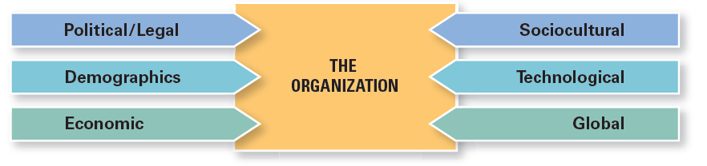
Exhibit 3-2 Components of External Environment
Exhibit 3-2 shows the different components that make up the external environment.

Slide 8
The Economic Environment
Managers need to be aware of the economic context so they can make the best decisions for their organizations.
Notes:
Like many global businesses, Nestlé is facing increased commodity costs. The maker of products from Crunch chocolate bars to Nescafé coffee to Purina pet food has seen the price of chocolate, for instance, increase by nearly 30 percent in five years. Overall, Nestlé spends more than $30 billion a year on raw materials.
Rising costs are also affecting the cost of sushi. Higher global demand for fish and the Japanese and U.S. currency exchange rates are influencing prices.
Commodity (raw materials) costs are just one of the many volatile economic factors facing organizations.

Slide 9
The Global Economy and the Economic Context
The lingering global economic challenges began with the turmoil in the U.S. housing market.
Notes:
The lingering global economic challenges—once described as the “Great Recession” by some analysts—began with the turmoil in the U.S. housing market.
As credit markets collapsed, businesses were impacted. Credit was no longer readily available to fund businesses. Economic difficulties spread across the globe.
The fragile economic recovery continues to be a business constraint.

Slide 10
Economic Inequality and the Economic Context
Polls show that in many countries, people believe that the gap between the rich and poor is problematic.
Notes:
As economic growth has languished and sputtered, and as people’s belief that anyone could prosper declined, social discontent over growing income gaps has increased.
Business leaders must realize that societal attitudes in the economic context have the potential to create constraints.
The bottom line is that business leaders need to recognize how societal attitudes in the economic context also may create constraints as they make decisions and manage their businesses.

Slide 11
The Demographic Environment
Age is a particularly important demographic since the workplace often has different age groups all working together
Baby Boomers
Gen Y (Millennials)
Post-Millennials
Notes:
The size and characteristics of a country’s population can have a significant effect on what it’s able to achieve in politics, economics, and culture.
Baby Boomers Born between 1946 and 1964, one of the largest and most influential demographic groups in history.
Gen Y or (Millennials)—Children of Baby Boomers, born between 1978 and 1994, making an impact on technology and the workplace.
Post-Millennials–The youngest group identified age group–basically teens and middle-schoolers. They have also been called the iGeneration because advances in technology have customized everything to the individual.
Population experts say it’s too early to tell whether elementary school-aged children and younger are part of this demographic group or whether the world they live in will be so different that they’ll comprise a different demographic cohort. Although this youngest group has not officially been “named,” some are referring to them as “Gen Z” or the “touch-screen generation.”

Slide 12
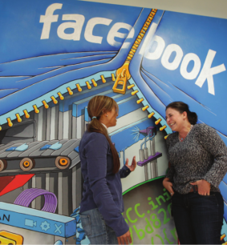
Gen Y
Gen Y is an important demographic at Facebook, where most employees are under 40.
Notes:
Gen Y is an important demographic at Facebook, where most employees are under 40. The company values the passion and pioneering spirit of its young employees who embrace the challenges of building groundbreaking technology and of working in a fast-paced environment with considerable change and ambiguity.
Source: Paul Sakuma/AP Images

Slide 13
How the External Environment Affects Managers
Jobs and Employment: the impact of external factors on jobs and employment is one of the most powerful constraints mangers face
Notes:
As any or all external environmental conditions (economic, demographic, technological, globalization, etc.) change, one of the most powerful constraints managers face is the impact of such changes on jobs and employment—both in poor conditions and in good conditions. The power of this constraint was painfully obvious during the last global recession as millions of jobs were eliminated and unemployment rates rose to levels not seen in many years. Businesses have been slow to reinstate jobs, creating continued hardships for those individuals looking for work.
Not only do changes in external conditions affect the types of jobs that are available, they affect how those jobs are created and managed. For instance, work tasks may be done by freelancers hired to work on an as-needed basis, or by temporary workers who work full-time but are not permanent employees, or by individuals who share jobs.

Slide 14
Assessing Environmental Uncertainty
Environmental uncertainty: the degree of change and complexity in an organization’s environment
Change: stable to dynamic
Complexity: simple to complex
Notes:
The first dimension of uncertainty is the degree of change. If the components in an organization’s environment change frequently, it’s a dynamic environment. If change is minimal, it’s a stable one. A stable environment might be one with no new competitors, few technological breakthroughs by current competitors, little activity by pressure groups to influence the organization, and so forth. When we talk about degree of change, we mean change that’s unpredictable. If change can be accurately anticipated, it’s not an uncertainty for managers.
The other dimension of uncertainty describes the degree of environmental complexity, which looks at the number of components in an organization’s environment and the extent of the knowledge that the organization has about those components. An organization with fewer competitors, customers, suppliers, government agencies, and so forth faces a less complex and uncertain environment. Complexity is also measured in terms of the knowledge an organization needs about its environment.

Slide 15
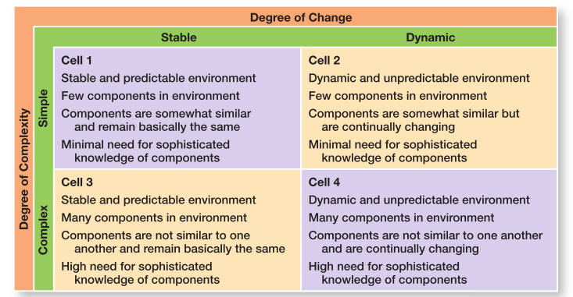
Exhibit 3-3 Environmental Uncertainty Matrix
Exhibit 3-3 shows the two aspects of environmental uncertainty, change and complexity.
Notes:
Environmental uncertainty refers to the degree of change and complexity in an organization’s environment. The matrix in Exhibit 3-3 shows these two aspects.
Looking at Exhibit 3-3, each of the four cells represents different combinations of degree of complexity and degree of change. Cell 1 (stable and simple environment) represents the lowest level of environmental uncertainty and cell 4 (dynamic and complex environment) the highest. Not surprisingly, managers have the greatest influence on organizational outcomes in cell 1 and the least in cell 4. Because uncertainty poses a threat to an organization’s effectiveness, managers try to minimize it.

Slide 16
Managing Stakeholder Relationships
Stakeholders: any constituencies in the organization’s environment that are affected by an organization’s decisions and actions
Notes:
The nature of stakeholder relationships is another way in which the environment influences managers. The more obvious and secure these relationships, the more influence managers will have over organizational outcomes.
Stakeholders are any constituencies in the organization’s environment affected by an organization’s decisions and actions. These groups have a stake in or are significantly influenced by what the organization does. In turn, these groups can influence the organization.
Management researchers who have looked at this issue are finding that managers of high-performing companies tend to consider the interests of all major stakeholder groups as they make decisions.

Slide 17
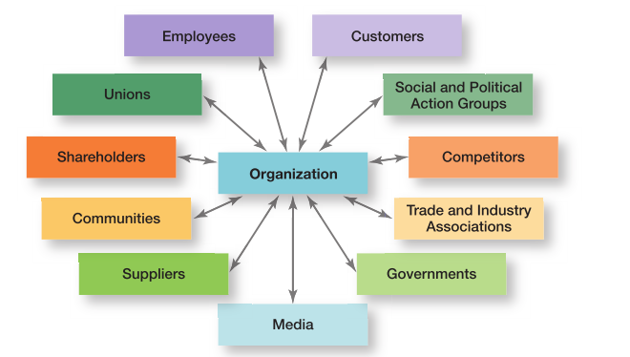
Exhibit 3-4 Organizational Stakeholders
Exhibit 3-4 identifies some of an organization’s most common stakeholders
Notes:
Exhibit 3-4 identifies some of an organization’s most common stakeholders. Note that these stakeholders include internal and external groups. Why? Because both can affect what an organization does and how it operates. For instance, the Dodd-Frank Act requires that many U.S. companies report their executives’ compensation in publicly available sources and in a manner that can be easily comprehended by the public at large. How would this information affect stakeholders?

Slide 18
Benefits of Good Stakeholder Relationships
Improved predictability of environmental changes
Increased successful innovations
Increased trust among stakeholders
Greater organizational flexibility to reduce the impact of change
Notes:
Another reason for managing external stakeholder relationships is that it’s the “right” thing to do. Because an organization depends on these external groups as sources of inputs (resources) and as outlets for outputs (goods and services), managers need to consider their interests as they make decisions.

Slide 19
Organizational Culture
Just as each individual has a unique personality, an organization, too, has a personality.
Notes:
Just as each individual has a unique personality—traits and characteristics influence the way we act and interact with others. An organization, too, has a personality, which is referred to as organizational culture.
An organization’s culture can make employees feel included, empowered, and supported or it can make them feel the opposite.
Because culture can be a very powerful agent in organizations, it is very important for managers to pay attention to it.

Slide 20
What is Organizational Culture?
Organizational culture: the shared values, principles, traditions, and ways of doing things that influence the way organizational members act and that distinguish the organization from other organizations
Notes:
In most organizations, these shared values and practices have evolved over time and determine, to a large extent, how “things are done around here.”
Our definition of culture implies three things. First, culture is a perception. It’s not something that can be physically touched or seen, but employees perceive it on the basis of what they experience within the organization. Second, organizational culture is descriptive. It’s concerned with how members perceive the culture and describe it, not with whether they like it. Finally, even though individuals may have different backgrounds or work at different organizational levels, they tend to describe the organization’s culture in similar terms. That’s the shared aspect of culture.

Slide 21
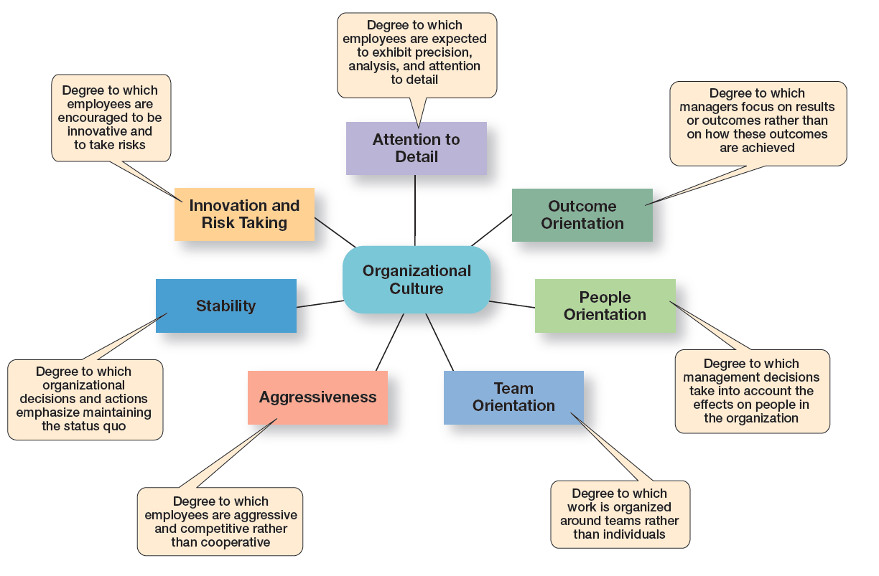
Exhibit 3-5 Dimensions of Organizational Culture
Exhibit 3-5 identifies the seven dimensions of organizational culture.
Notes:
Research suggests seven dimensions that seem to capture the essence of an organization’s culture. These dimensions (shown in Exhibit 3-5) range from low to high, meaning it’s not very typical of the culture (low) or is very typical of the culture (high). Describing an organization using these seven dimensions gives a composite picture of the organization’s culture.

Slide 22
Contrasting Organizational Culture
At Tesla Motors, the focus is product innovation (innovation and risk taking).
In contrast, Southwest Airlines has made its employees a central part of its culture.
Notes:
In many organizations, one cultural dimension often is emphasized more than the others and essentially shapes the organization’s personality and the way the organization works. Exhibit 3-6 describes how the dimensions can create significantly different cultures.

Slide 23
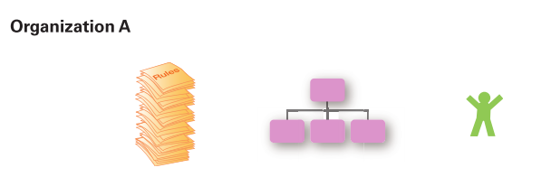
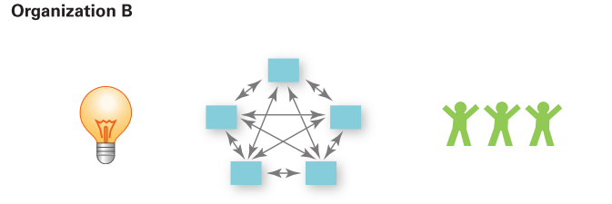
Exhibit 3-6 Contrasting Organizational Culture
Risk-taking and change discouraged
Creativity discouraged
Close managerial supervision
Work designed around individual employees
Risk-taking and change rewarded
Creativity and innovation rewarded
Management trusts employees
Work designed around teams
Notes:
Exhibit 3-6 illustrates how the dimensions of culture can create significantly different cultures.
Both Organization A and Organization B are manufacturing firms, but each company emphasizes a different dimension that have shaped organizational culture.

Slide 24
Strong Cultures
Strong cultures: organizational cultures in which the key values are intensely held and widely shared
Notes:
Strong cultures have a greater influence on employees than weaker cultures. (Exhibit 3-7 contrasts strong and weak cultures.)
The more employees accept the organization’s key values and the greater their commitment to those values, the stronger the culture. Most organizations have moderate to strong cultures; that is, there is relatively high agreement on what’s important, what defines “good” employee behavior, what it takes to get ahead, and so forth. The stronger a culture becomes, the more it affects the way managers plan, organize, lead, and control.

Slide 25
Exhibit 3-7 Strong Versus Weak Cultures
Strong Cultures | Weak Cultures
Values widely shared | Values limited to a few people – usually top management
Culture conveys consistent messages about what’s important | Culture sends contradictory messages about what’s important
Most employees can tell stories about company history or heroes | Employees have little knowledge of company history or heroes
Employees strongly identify with culture | Employees have little identification with culture
Strong connection between shared values and behaviors | Little connection between shared values and behaviors
Notes:
Why is having a strong culture important? For one thing, in organizations with strong cultures, employees are more loyal than employees in organizations with weak cultures.
Research also suggests that strong cultures are associated with high organizational performance. However, the drawback is that a strong culture also might prevent employees from trying new approaches, especially when conditions change rapidly.

Slide 26
Where Culture Comes From and How it Continues
The original source of the culture usually reflects the vision of the founders.
Once the culture is in place, certain organizational practices help maintain it.
The actions of top managers also have a major impact on the organization’s culture.
Notes:
Company founders are not constrained by previous customs or approaches and can establish the early culture by articulating a vision of what they want the organization to be. Also, the small size of most new organizations makes it easier to instill that vision with all organizational members.
Once the culture is in place, however, certain organizational practices help maintain it. For instance, during the employee selection process, managers typically judge job candidates not only on the job requirements, but also on how well they might into the organization. At the same time, job candidates find out information about the organization and determine whether they are comfortable with what they see.
Through what they say and how they behave, top managers establish norms that filter down through the organization and can have a positive effect on employees’ behaviors. For instance, Gravity CEO, Dan Price, raised the minimum wage at his firm to $70,000 annually and has cut his million dollar salary to fund those pay increases. Since making this decision, Gravity’s financial performance has soared.
However, as we’ve seen in numerous corporate ethics scandals, the actions of top managers also can lead to undesirable outcomes.

Slide 27
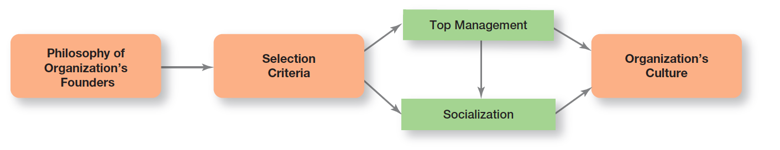
Exhibit 3-8 Establishing and Maintaining Culture
Exhibit 3-8 illustrates how an organization’s culture is established and maintained.
Notes:
Exhibit 3-8 illustrates how an organization’s culture is established and maintained.

Slide 28
How Employees Learn Culture
Stories
Rituals
Material Artifacts and Symbols
Language
Notes:
Organizational “stories” typically contain a narrative of significant events or people, including such things as the organization’s founders, rule breaking, reactions to past mistakes, and so forth. To help employees learn the culture, organizational stories anchor the present in the past, provide explanations and legitimacy for current practices, exemplify what is important to the organization, and provide compelling pictures of an organization’s goals.
Corporate rituals are repetitive sequences of activities that express and reinforce the important values and goals of the organization. One of the best-known corporate rituals is Mary Kay Cosmetics’ annual awards ceremony for its sales representatives.
The layout of an organization’s facilities, how employees dress, the types of automobiles provided to top executives, and the availability of corporate aircraft are examples of material symbols. Others include the size of offices, the elegance of furnishings, executive “perks” (extra benefits provided to managers such as health club memberships, use of company-owned facilities, and so forth), employee fitness centers or on-site dining facilities, and reserved parking spaces for certain employees.
Many organizations and units within organizations use language as a way to identify and unite members of a culture. Over time, organizations often develop unique terms to describe equipment, key personnel, suppliers, customers, processes, or products related to its business. New employees are frequently overwhelmed with acronyms and jargon that, after a short period of time, become a natural part of their language. Once learned, this language acts as a common denominator that bonds members.

Slide 29
How Culture Affects Managers
Because an organization’s culture constrains what they can and cannot do and how they manage, it’s particularly relevant to managers.
Notes:
Such constraints are rarely explicit. They’re not written down. It’s unlikely they’ll even be spoken. But they’re there, and all managers quickly learn what to do and not do in their organization.
The link between values such as these and managerial behavior is fairly straightforward. Take, for example, a so-called “ready-aim- re” culture. In such an organization, managers will study and analyze proposed projects endlessly before committing to them. However, in a “ready- re-aim” culture, managers take action and then analyze what has been done.

Slide 30
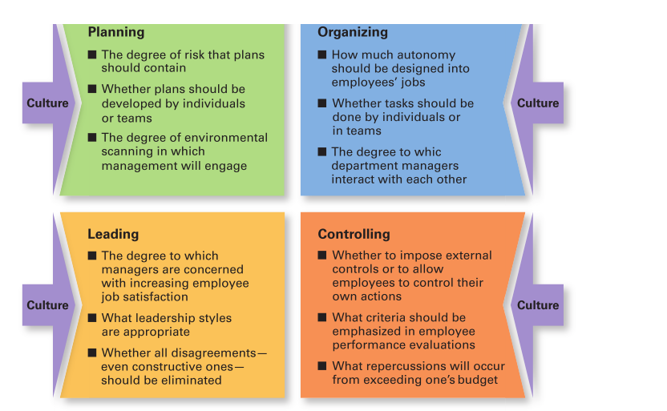
Exhibit 3-9 Types of Managerial Decisions Affected by Culture
As shown in Exhibit 3-9, a manager’s decisions are influenced by the culture in which he or she operates.
Notes:
As shown in Exhibit 3-9, a manager’s decisions are influenced by the culture in which he or she operates. An organization’s culture, especially a strong one, influences and constrains the way managers plan, organize, lead, and control.

Slide 31
Creating an Innovative Culture
Challenge and involvement
Freedom
Trust and openness
Idea time
Playfulness/humor
Conflict resolution
Debates
Risk taking
Notes:
How important is culture to innovation? In a survey of senior executives, over half said that the most important driver of innovation for companies was a supportive corporate culture. But not every company has established an adequate culture to foster innovation. In a survey of employees, about half expressed that a culture of management support is very important to the generation of innovative ideas, but only 20 percent believe that management actually provides such support.
What does an innovative culture look like? According to Swedish researcher Goran Ekvall, it would be characterized by the bullet points listed on the slide.

Slide 32
Exhibit 3-10 Creating a Customer Responsive Culture
Characteristics of Customer Responsive Culture | Suggestions for Managers
Type of employee | Hire people with personalities and attitudes consistent with customer service: friendly, attentive, enthusiastic, patient, good listening skills
Type of job environment | Design jobs so employees have as much control as possible to satisfy customers, without rigid rules and procedures
Empowerment | Give service-contact employees the discretion to make day-to-day decisions on job-related activities
Role clarity | Reduce uncertainty about what service-contact employees can and cannot do by continual training on product knowledge, listening, and other behavioral skills
Consistent desire to satisfy and delight customers | Clarify organization’s commitment to do whatever it takes, even if it’s outside an employee’s normal job requirements
Notes:
What does a customer-responsive culture look like? Exhibit 3-10 describes five characteristics of customer-responsive cultures and offers suggestions as to what managers can do to create that type of culture.

Slide 33
Creating a Sustainability Culture
For many companies, sustainability is developed into the organization’s overall culture.
Notes:
Companies can create rituals to create and maintain sustainability cultures. Earlier in this chapter, we referred to Convergint Technologies’ “Social Responsibility Day.” Alternatively, managers may use rewards. For instance, global polystyrene leader, Styron LLC, has more than 2,000 employees at 20 plants worldwide with annual sales of $5 billion. Management begins each corporate meeting with the topic of sustainability. Employees’ bonuses are tied to meeting sustainability goals. Management’s e orts seem to be working: Recently, Styron introduced a re-cycled-content grade of polycarbonate at the Chinaplas trade show in Guangzhou, China.

Slide 34
Review Learning Objective 3.1
Contrast the actions of managers according to the omnipotent and symbolic views.
Omnipotent view: Managers are directly responsible for the organization’s success or failure.
Symbolic view: Much of the organization’s success or failure is due to external forces outside of the manager’s control.
The two constraints on managers' discretion are organizational culture (internal) and the environment (external).

Slide 35
Review Learning Objective 3.2
Describe the constraints and challenges facing managers in today’s external environment.
The external environment includes those factors and forces outside the organization that affect its performance).
The main components of the external environment are economic, demographic, political/legal, sociocultural, technological, and global.
These components can constrain and challenge managers because they have an impact on jobs, environmental uncertainty, and stakeholder relationships.

Slide 36
Review Learning Objective 3.3
Discuss the characteristics and importance of organizational culture.
The seven dimensions of culture are: attention to detail, outcome orientation, people orientation, team orientation, aggressiveness, stability, innovation, and risk taking.
The stronger the culture, the greater the impact on the way managers plan, organize, lead, and control.
The original source of the organizational culture reflects the founder’s vision.
Culture is transmitted through stories, rituals, material symbols, and language.

Slide 37
Review Learning Objective 3.4
Describe current issues in organizational culture.
The characteristics of an innovative culture are challenge and involvement, freedom, trust and openness, idea time, playfulness/humor, conflict resolution, debates, and risk taking.
A customer responsive culture has five characteristics: outgoing and friendly employees; jobs with few rigid rules, procedures, and regulations; empowerment; clear roles and expectations; and employees who are conscientious in their desire to please the customer.
Companies that achieve business goals and increase long-term share-holder value by integrating economic, environmental, and social opportunities into business strategies may develop sustainability into the organization’s overall culture.

Slide 38
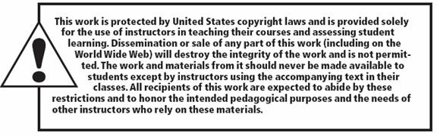
Copyright

